Slide 1
EWM Extended Warehouse Management

Slide 2
Introduction
Extended Warehouse Management Was introduced in October, 2005. Although it is not a replacement for the SAP Standard warehouse management application, it represents a new generation of SAP Warehouse management software.
The introduction of the SAP EWM system does not mean that it replaces the SAP WM system. It just means that there is now an additional alternative for those warehouse that require the functionality provide by EWM.

Slide 3
Introduction
In 2005, SAP announced the availability of its Service Parts Management (SPM) System, Extended Warehouse Management (EWM) Was an integral component of this system.
Today EWM is considered a standalone application that can be used in any Warehouse environment and it does not require any connection to SPM

Slide 4
Reason for developing a new SCM-Based WMS
Requirements for data volume, performance and process flexibility made a new architecture necessary.
Fallowing the Decentralized SAP Warehouse concept.
Mind shift from managing stocks to controlling process.

Slide 5
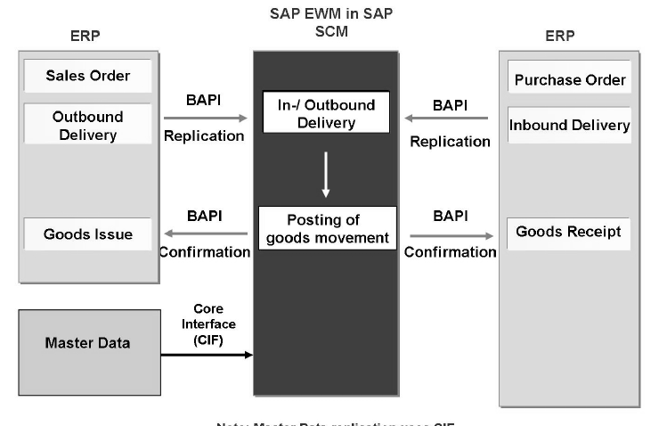
Interface

Slide 6
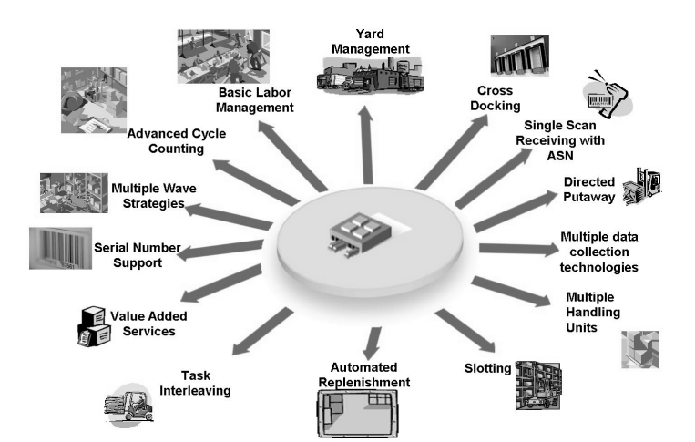
EWM Functions

Slide 7
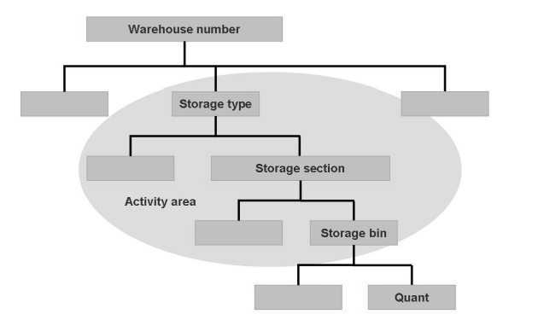
EWM Structure

Slide 8
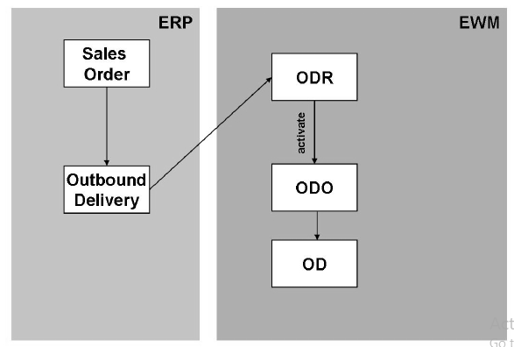
Outbound delivery

Slide 9
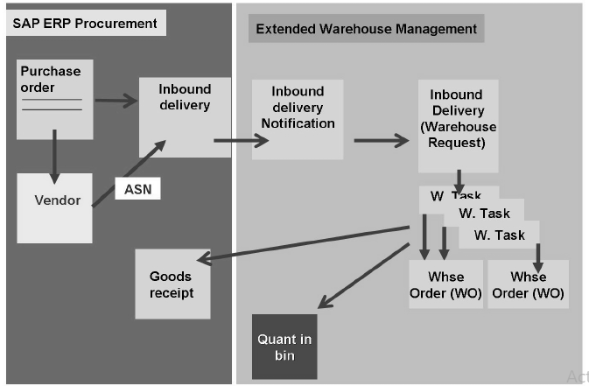
Inbound delivery

